Slide 1
WEB APPLICATION DEVELOPMENT TRAINING
WEEK 8 DAY 1 LECTURE SLIDES
PHP FORM DATA

Slide 2
Introduction to PHP Forms
A [HTML] form is a document that contains fields where the user can fill in data or user can select from existing data.
Forms is the basis for building a dynamic website
Dynamic websites provide the functionalities that can use to store, update, retrieve, and delete the data in a database.
Class work: Create a registration form for the Class Management App. The form should have fields for capturing the data for which you have created students table for in the db*
The action and method attributes of your form : Action specifies where the form values should be passed to, Method specifies the means of getting the variables across.
Notes:
* Creation of the table was done during the database class

Slide 3
Statelessness of HTTP and Data Retention
HTTP is a stateless protocol - statelessness means that when you transition from one web page to another, all variables [and their values] are forgotten.
Data Retention is achieved through:
  Passing the values
  Cookies and Sessions
  Database lookup

Slide 4
Passing Values – POST and GET
$_POST and $_GET are reffered to as super global variables which means that they are always accessible, regardless of scope - and you can access them from any function, class or file without having to do anything special.
They create an array that holds key/value pairs, where keys are the names of the form controls and values are the input data from the user.
$_GET is an array of variables passed via the URL parameters.
$_POST is an array of variables passed via the HTTP POST method.

Slide 5
The $_GET Superglobal
Information sent from a form with the GET method is visible to everyone (all variable names and values are displayed in the URL).
GET has limits on the amount of information to send. The limitation is about 2000 characters.
However, because the variables are displayed in the URL, it is possible to bookmark the page. This can be useful in some cases.
GET may be used for sending non-sensitive data.
Notes:
Warning!!! Do not use $_GET in passing passwords!

Slide 6
The $_GET Superglobal
The GET method simply passes variable name/value pairs on the URL after a question mark.
See welcome.php?username=‘james’&level=1
This method can be sent by all web pages, whether or not the transfer mechanism is a link or a form's submit button.
Security Downsides of $_GET
Notes:
Crackers and script kiddies can tack malicious commands on the end of an otherwise good URL. Be sure every page receiving GET requests immediately truncates excess characters from the URL.
The variables are plain text and are subject to tampering by the user. On visiting an ecommerce site using the GET method, I may be able to modify the URL such that I could purchase a N10,000 book for N100 except if there are further checks

Slide 7
The $_POST Super global
Information sent from a form with the POST method is invisible to others (all names/values are embedded within the body of the HTTP request) and has no limits on the amount of information to send.
POST supports advanced functionality such as support for multi-part binary input while uploading files to server. (File Upload)
However, because the variables are not displayed in the URL, it is not possible to bookmark the page.

Slide 8
The $_POST Super global
The POST method of value passing is available ONLY from HTML forms. It cannot be applied by links, even if those links are contained within a form.
With the $_POST superglobal, to retain state without resorting to the GET method, every exit point on every page must be a button on a form.
It is the most secure method of passing data between pages.

Slide 9
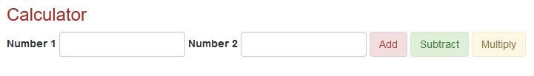
Classwork
Implement the calculator below:

Slide 10
Classwork
On Your Students’ Registration Form, accept data and check the fields that are blank. Display the fields that are blank to the user
The empty() function – used to check if a variable has no value

Slide 11
Securing Your Form Data
strip_tags — Strip HTML and PHP tags from a string – Used when you are not expecting data with tags
Syntax :string strip_tags ( string $str [, string $allowable_tags ] ) eg strip_tags($input, '<br>');
Classwork : capture the user’s favourite webpage. Use the allowable tags to allow him enter the url
Notes:
* Optional argument $allowable_tags specifies the tags you want to allow in the string

Slide 12
Securing Your Form Data
Certain characters have special significance in HTML, and should be represented by HTML entities if they are to preserve their meanings. Then, there is a justifiable need to use some tags
Htmlspecialchars() - Convert special characters to HTML entities
Htmlentities() – does full entity conversion.
The trim() function – Used to remove trailing spaces
Stripslashes() and addslashes()
Passing tokens through the hidden variable
Use of Captcha – Later Class
Notes:
Optional argument $allowable_tags specifies the tags you want to allow in the string
<script>alert('hacked')</script>

Slide 13
Checkbox Group – Form Array Variables
There are often situations where a group of related checkboxes are needed on a form.
The advantage of check box group is that the user can select more than one options.
To do this, give the checkboxes the exact same name ( menu[ ] ). Ensure that each name ends in [ ].
Using the same name indicates that these checkboxes are all related. Using [ ] indicates that the selected values will be accessed by PHP script as an array. That is, $_POST[‘menu’] won’t return a single string; it will instead return an array consisting of all the values of the checkboxes that were checked.
Notes:
Classwork:

Slide 14
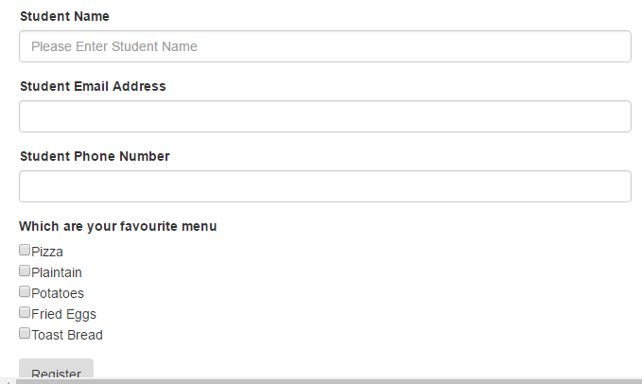

Slide 15
What Else Can you do with Your Form Data?

Slide 16
Saving Data in a File
file_put_contents function is used to write a string to a file
int file_put_contents ( string $filename , mixed $data [, int $flags = 0 [, resource $context ]] )
Simple format is: file_put_contents($filename,$data)
Where $filename is the path to the file where to write the data $data
This function returns the number of bytes that were written to the file, or FALSE on failure.
Notes:
Class work:
The admin has been disconnected from the internet for his uncontrollable use of the company’s resources. However, we want to notify him of new registrations by creating text files. Using the file_puts_contents function, generate a text file and save information (firstname, lastname, phone, email) of all new registrations. (Introduce to Heredoc syntax in PHP)
2. Modify your code in such a way that the filename is the combination of the user’s firstname_lastname. Implement in such a way that when the values are entered in uppercase. Only the lower case equivalent of the filename is acceptable as the system in use is Linux. Use the strtolower() function in PHP

Slide 17
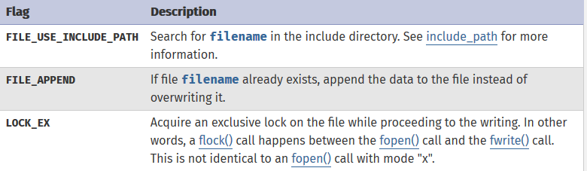
Saving Data in a File – Available Flags

Slide 18
Saving Data in a File
file_put_contents(“people.txt”, ”You are welcome to the academy”);
Exercise: Using the Class Management App designed from previous class, capture the registration details of students and save in files, save each file using the students’s first name
Notes:
Assignment: For The Registration Form, capture the user’s input and generate a txt file that contains the inputs from the user.
A) For your filename, use the first name supplied by the user. Eg If a user supplies James Udoh, let the file name be “James.txt”
B) For your file name, replace all spaces in the name with underscore (_)
Example if the user supplies Adeola Mary John, your file name will be “Adeola_Mary_John.txt”

